Slide 1
AZURE DEVOPS

Slide 2
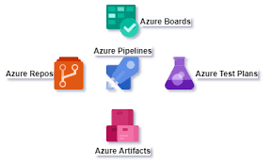
Components of Devops Azure

Slide 3
AZURE BOARDS
Azure boards is an interface or a service of DevOps through which teams can manage their projects throughout the entire development lifecycle.
It allows the team to track their tasks, work status, user stories, backlogs, features, and track bugs and defects that are noticed in the project.
The three basic work items are Epics, Issues, and Task.

Slide 4
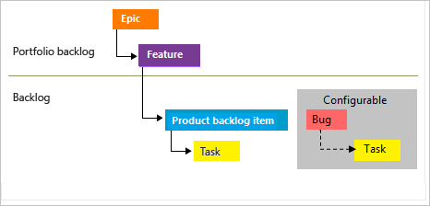
The status of a particular task gets updated as the work progresses, through various stages, typically “To Do”, “Doing” and “Done”. As you update the task, it progresses through the different stages.
The image below depicts these item in the context of the overall workflow:

Slide 5
Features of Azure Boards
Scalability
The system scales as the organization and team grows – this is critical to ensure we can measure and manage the work regardless of the organization or project size.
Interactive/Visual tools and easy to customize
Work progress can be easily monitored and customize boards, using common configurable dialog.
Built-in Tools and capture information
Items are designed to help in Editing, adding images, and attachments can be done on these work items.
Extensions
You can achieve more functionality by adding a Marketplace extension. Extensions are installable units that add enhancements to the already existing tools.
Integration with GitHub
It is easy to connect to GitHub and you can perform a pull, push, and commit requests easily.

Slide 6
Creating a new task in Azure Boards
The main boards interface has four sections, the main Azure boards tab, work items, issues and project and team member management, The first one gives access to all the major tabs of Azure Boards.
The second is to add work items.
The third one is for issues and
The fourth is to manage projects and team members. The most common action you will be carrying out is creating and managing tasks for the team.

Slide 7
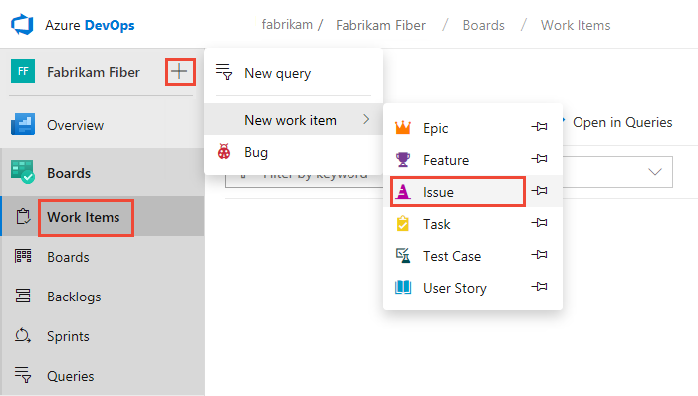

Slide 8
Azure Dashboards
Azure Dashboards are used to add widgets for graphical representations to your project. We have Azure DevOps marketplace to add widgets as per our requirement by clicking on the "Add a widget" button. We can customize and configure dashboards to your teams. It will help to monitor progress, improve your workflow processes and information about the project.
Features
Dashboards, Charts, Widgets, Power BI reports, System generated reports, Quick Links by using charts.

Slide 9
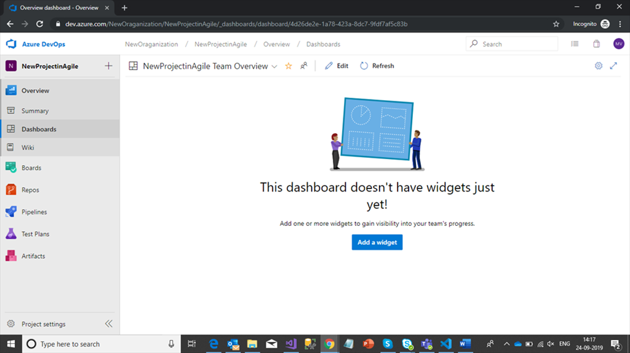

Slide 10
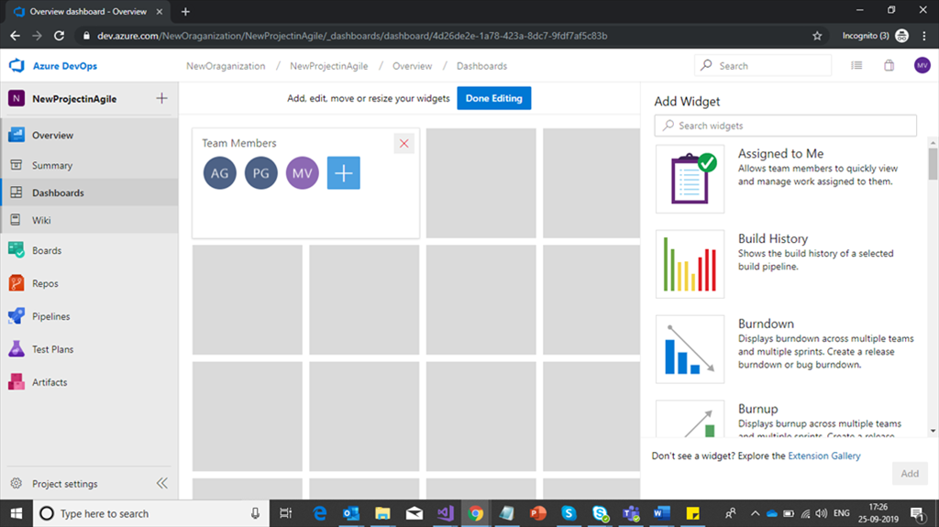
You'll get an option to select widgets to visualize the items as shown in below screen. If you want more widget items click on this URL: https://marketplace.visualstudio.com/ to configure.

Slide 11
Azure Boards
Azure boards are used to create story points, features and epics for planned sprint releases in our organization and track work items with Kanban boards, backlogs, team dashboards and custom reporting. You can quickly and easily start tracking user stories, backlog items, task, features, and bugs associated with your project.
Below are the components available in Azure boards.
Work Items
Boards
BackLogs
Sprints
Queries

Slide 12
Work Items
Work items is a collection of epics, features, issues, bugs, test cases, user stories etc. to track the features and requirements for developing code in project.

Slide 13
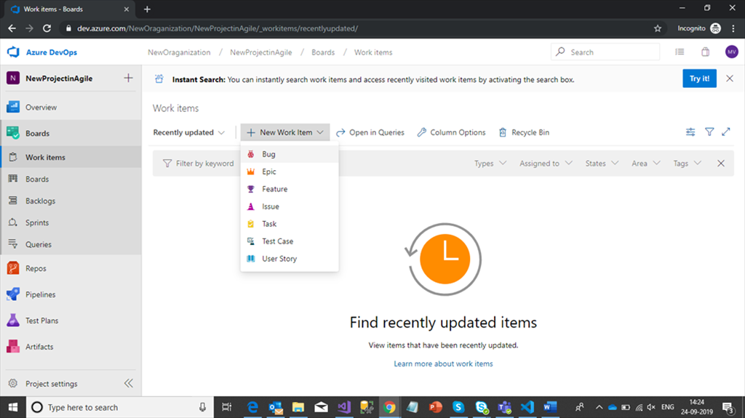

Slide 14
Features for Work Items:
We can upload work items manually from application or else we can connect devops project by using teams extensions in Excel.
Follow below link for Working with Excel.
https://docs.microsoft.com/en-us/azure/devops/boards/backlogs/office/track-work?view=azure-devops
Now create one Excel workbook for managing all work items.
You need to add team plugin
Select New List
Connect your TFS server (Azure Devops Server) by clicking on the servers button.
In Server windows, add your project URL as shown in the below screenshot.

Slide 15
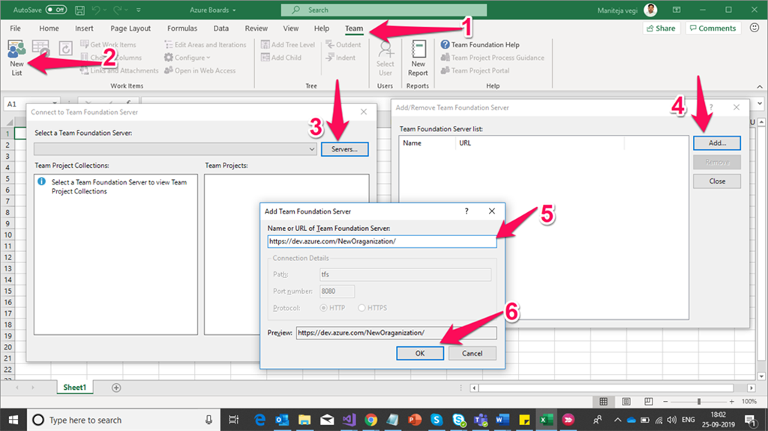

Slide 16
After clicking on OK, It will redirected to login authenticate with your username and password. Once you're done with your login, add your project and select input list for default template. Fill your story points for sprint releases by selecting dropdown options in WorkItem type, State, Reason, Assigned To.

Slide 17
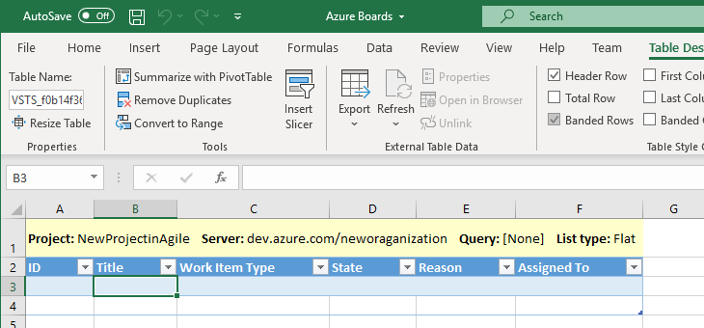

Slide 18
Here we will check how Azure Boards will help to execute.
Scrum Master/Project Manager knows the features, epics, tasks, stories, allocation resources for sprints, task cards etc. All this type management activity will happen in this Azure Boards.
We will discuss more about Azure boards and basic use cases step by step.
Now our PM has planned an activity to release one registration page and login page for the first sprint.
Now the organizatio'sn HR has allocated resources for a brand new project, and below is the initial resources list

Slide 19
Name | Mail ID | Expertise
N Kumar | naveen@abc.com | Technical Architect
M Kumar | mani@abc.com | Full Stack Developer
A Reddy | avinash@abc.com | Full Stack Developer
R Kumar | ravi@abc.com | Tester
Azure Devops engineer will create some Azure resources like Devops Azure project for build, test and release applications, Azure App services, Azure Database etc.

Slide 20
Sprint 1 Requirments (For Example):
Epics | Features | Stories | Tasks
User Information | User Information Storage | Create a registration page. | Create a table for maintaining user information, Create a page for UI, Create method to handle Create operation
 |  | Create a login page | Create a page for UI for login page, Create a method to handle login operations, Maintain validations as per initial test cases.
We're uploading the above requirements WBS (Work Breakdown Stories) to Azure work items by using an Excel sheet as shown in the below screenshot.
Prepare your work items as shown in the below figure and publish work items to Azure work items.

Slide 21
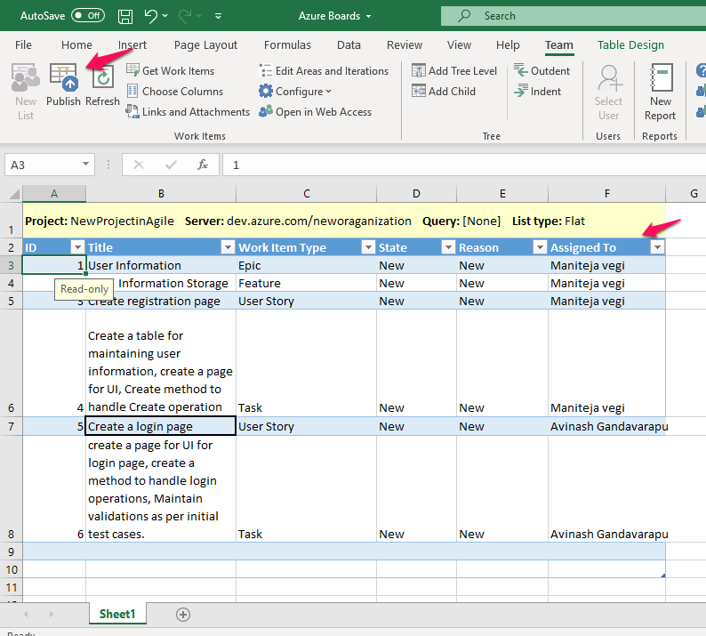

Slide 22
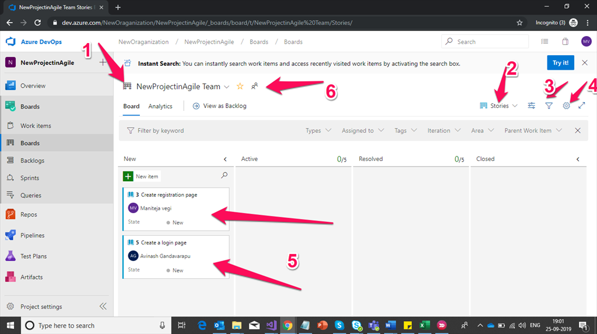
Once your work items are published, they will be available in Work Items under Azure Boards.

Slide 23
Features:
You can configure multiple Kanban Boards for your project requirement.
You can Filter Work Item Types by selecting dropdown show in above screenshot.
You can filter your workitems.
You can customize your Kanban boards with ‘n’ no. of States, Colours for cards etc.
Monitoring work items are available in the present Kanban board.
In the middle of the sprint you can manage your team by adding or removing team members to work in Iterations (Sprints).
You can prioritize your work items by giving tag information and color codings.
You can block your final states by product owners by restricting access to other team members.

Slide 24
Backogs in Azure Boards
In backlogs, complete work items will be available to distribute each iteration (sprint) to the sprint delivery. You can drag and drop work items to include them in an iteration (sprint).Backlogs display work items as a list and boards display them as cards. You can quickly plan your project by adding user stories or requirements to your product backlog. Once you have your plan in place, you can start driving code development efforts by assigning cards to your employees (Developers, Testers etc).

Slide 25
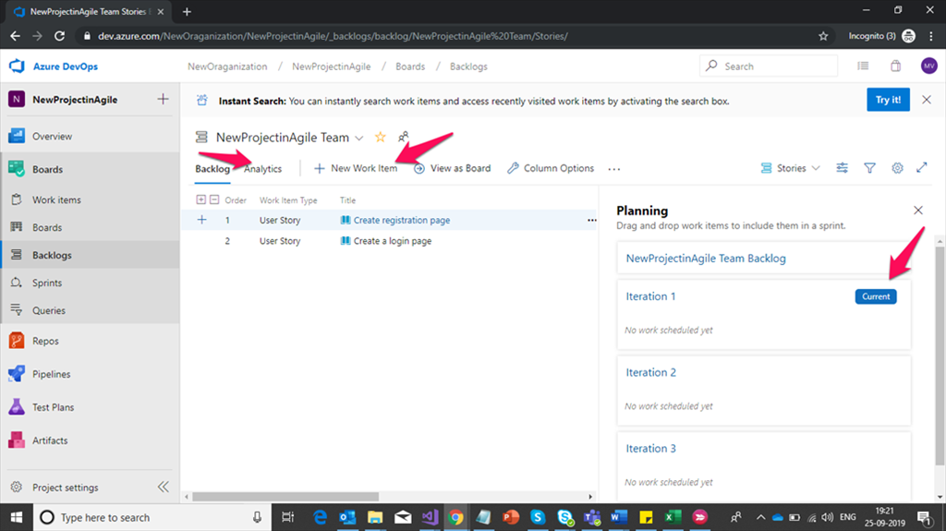

Slide 26
Sprints in Azure Boards
Iteration information available in this section is to track sprint delivery dates, work items, sprints history, capacities of resources assigned to sprints, analytics (Burndown Trend), task board for current and previous sprints, work items tracking etc. You can easily search, drag and drop work items (backlog items) to planned sprints. You can set sprint capacity by adjusting your work to fit in the sprint capacity plan.

Slide 27
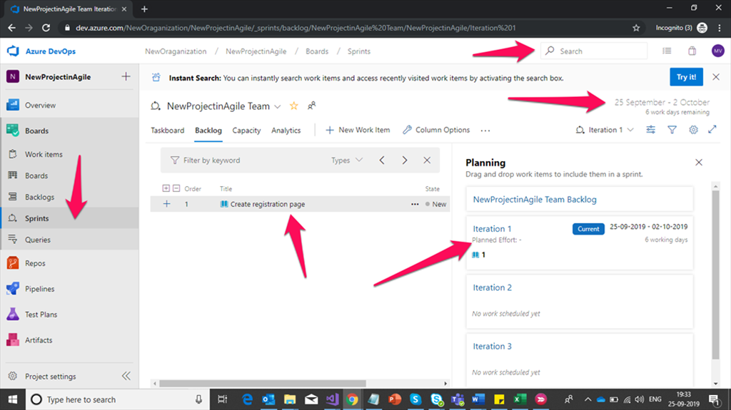

Slide 28
Queries in Azure Boards
You can create public and private queries as per project requirement, Eg: I need to know all work items available in this sprint using queries and I’ll generate charts by using those queries and binding them in Dashboards. Also bulk add or removing work items, tags etc.

Slide 29
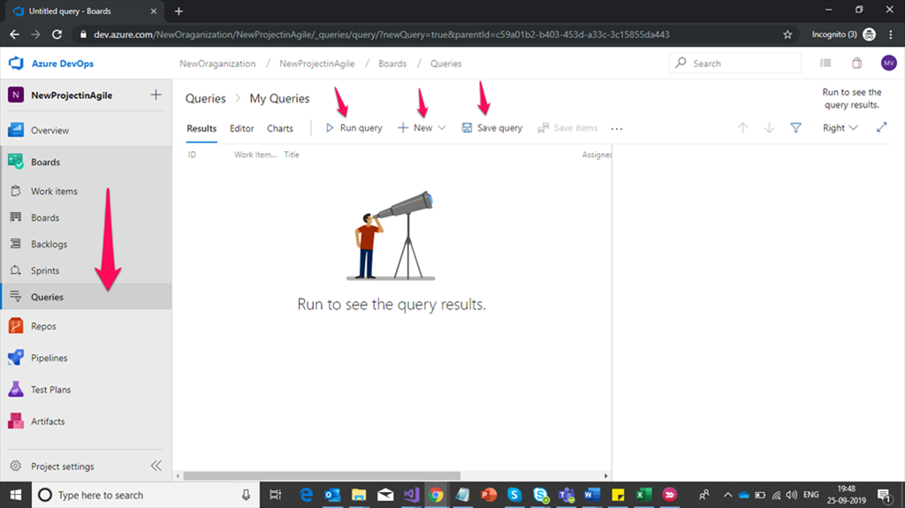

Slide 30
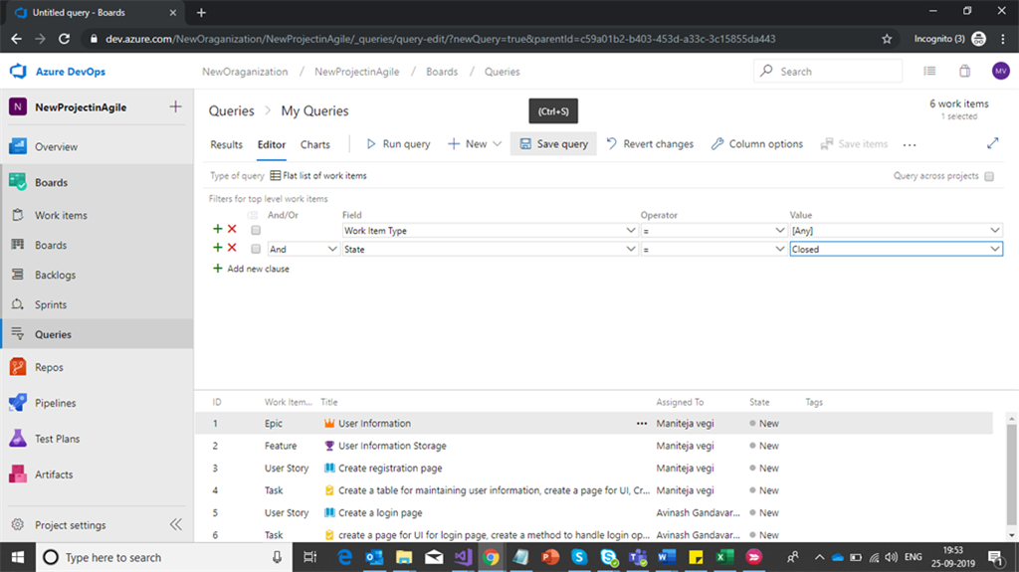
Create a Query

Slide 31
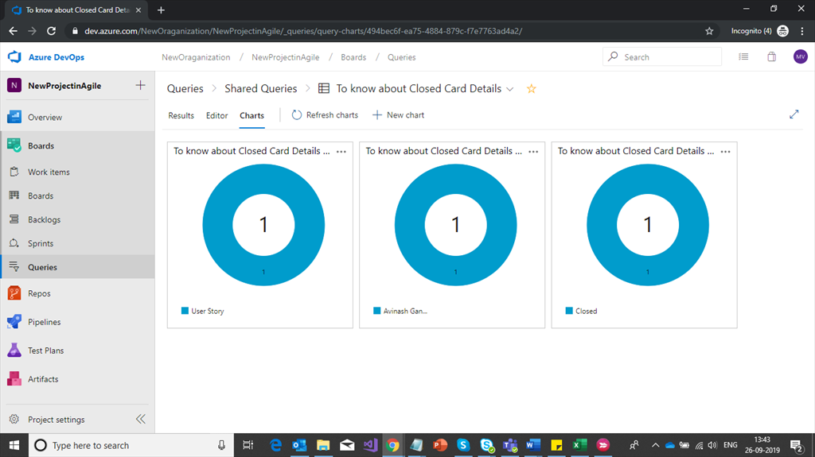
Closed Work Items

Slide 32
Azure DevOps Pipelines
Azure pipelines are used mainly to automate your build and deployments by using Continuous Integration and Continuous Deployment (CI & CD). No need to spend much time on deployment. For every commit from developer branch, approved PR’s (Pull requests) with manager, we can configure, automate, or manually approve a limit by giving access to each environmental staging. We will discuss this more in depth in upcoming articles about Azure pipelines.
Main Components in Azure Pipelines
Builds,
Releases,
Library,
Task Groups,
Deployment groups

Slide 33
Builds
This build pipeline helps to perform various tasks to build your pipeline, tasks like GIT Repository, restoring dependencies, compiling the application, run configured tests and publishing outputs for deployments.

Slide 34
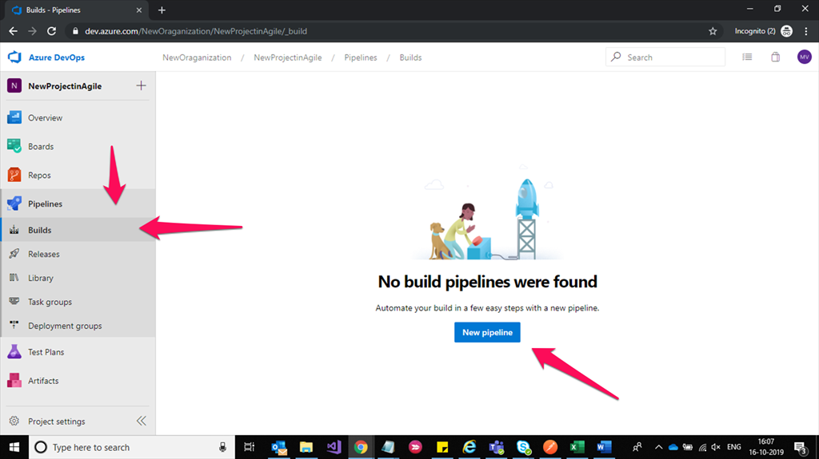

Slide 35
New Pipeline
Once you click on New pipeline and page is redirected to configure your connected sources to build, i.e, CI(Continuous Integration), click on User classic editor.

Slide 36
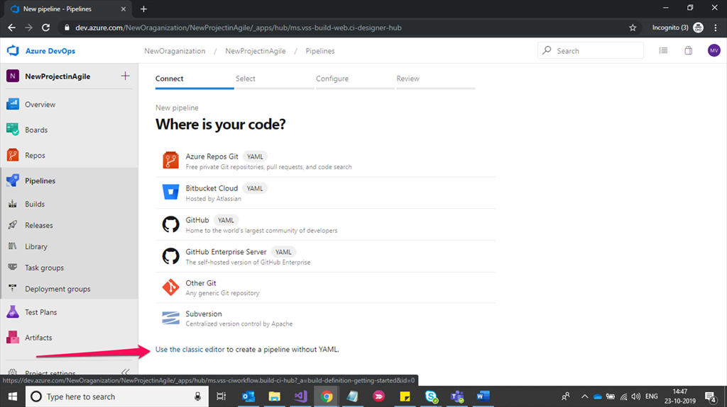

Slide 37
Through classic view editor, we can achieve Continuous Integration for build pipeline, here we need to select our Repository details available in Azure DevOps.

Slide 38
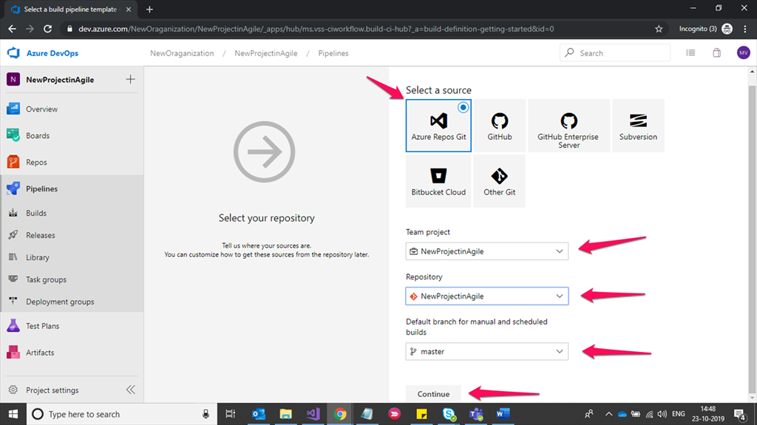

Slide 39
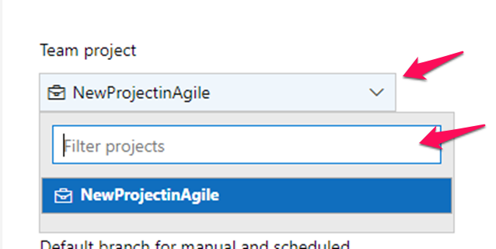
Here we have to configure Team Project (An Organization consists of ‘n’ number of projects). You have to select valid project details for CI’s (Continuous Integration).

Slide 40
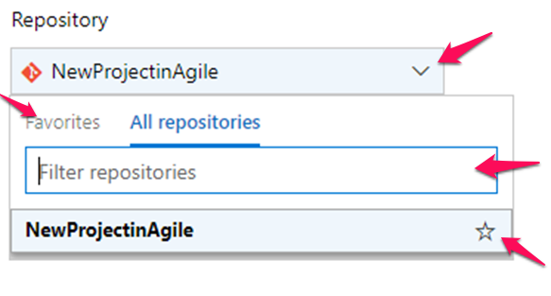
Repository
We have an option to maintain multiple repos for Single Project. So we have to choose valid repos for CI’s process.

Slide 41
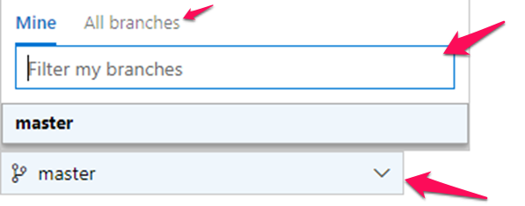
Branches
From repos, we can create multiple branches for the development team. So here I’m showing only with master branch for CI process.

Slide 42
Fill all the required information and click on continue to pipeline job.
Once repository configuration is done and we have to configure a job to build repository code, we have multiple items to choose featured apps as shown in the below figure, or else we can create our own job by selecting Empty job option.

Slide 43
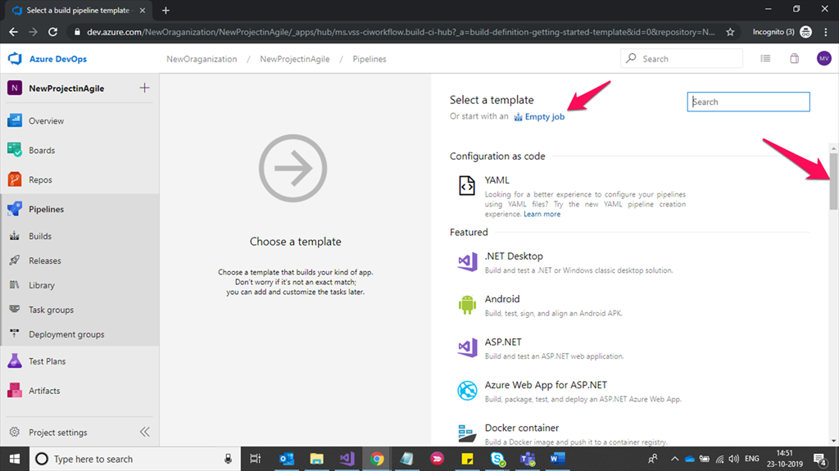

Slide 44
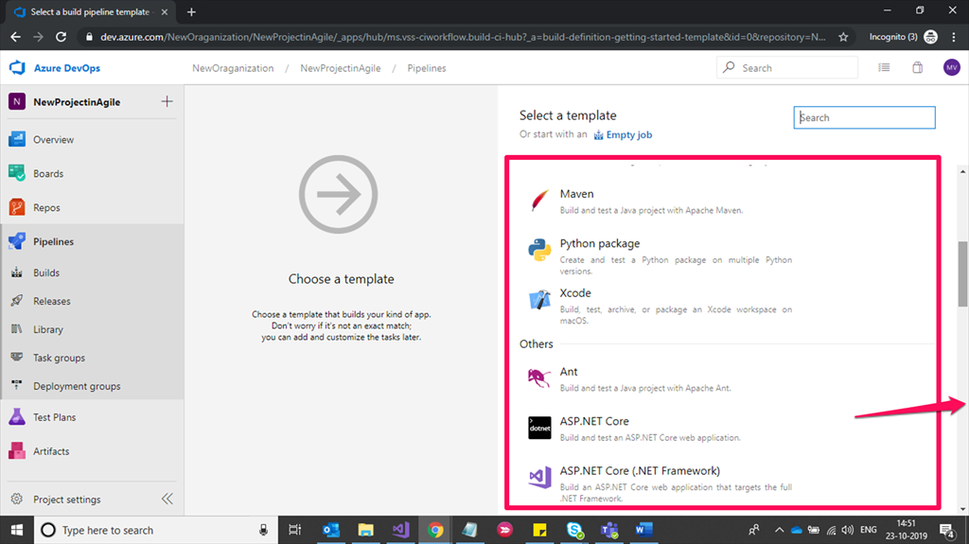

Slide 45
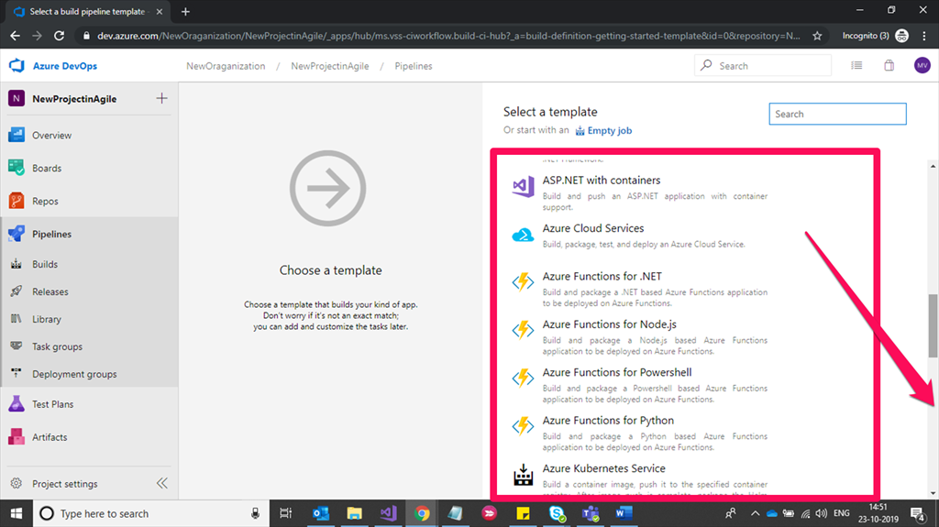

Slide 46
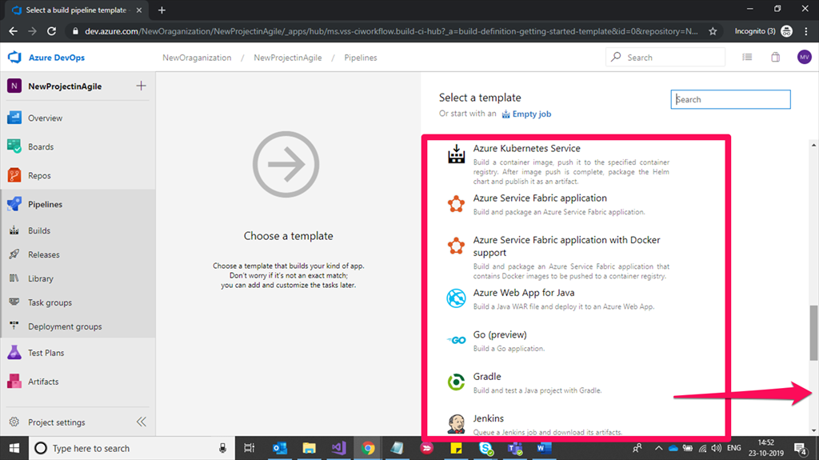

Slide 47
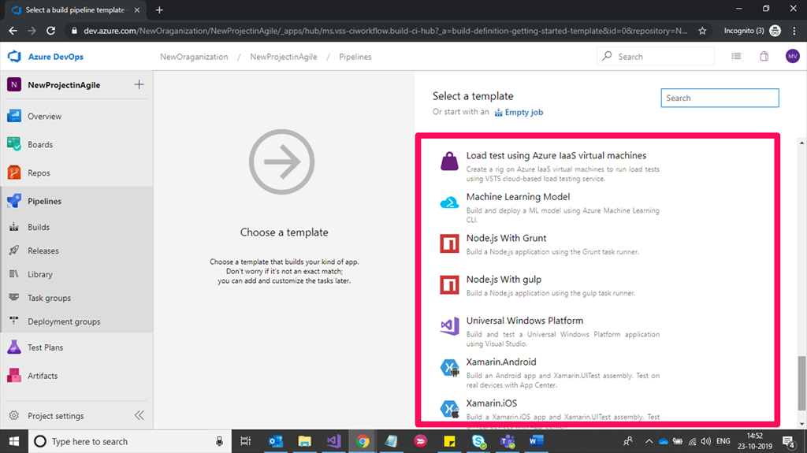

Slide 48
Select ASP.NET application template as of now to create build job and Click on Apply button.

Slide 49
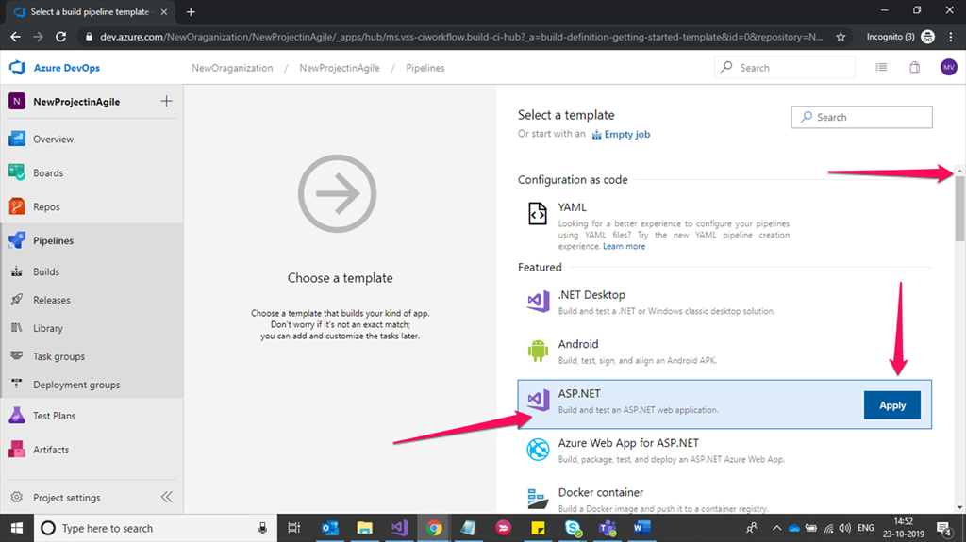

Slide 50
In this section, we have to configure Agent jobs (In this agent jobs complete repos code was built in the cloud, restoring the nuget package manager for project dependencies), default artifact information (Once our code is successfully built we get an artifact to deploy it in configured stages), Click on Save & Queue. More about this Agent job execution sequence and real time usages will be detailed in next articles.
In Tasks option, our template job sequenece will be available to build the repos code,
In Variables option we can declare our environment variables based on Dev, Test and Prod environments,
We need to give a Name for Continous Integration.

Slide 51
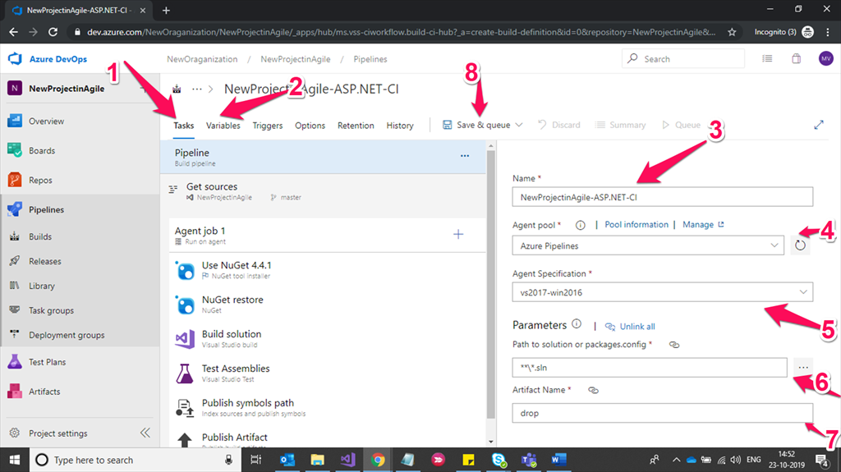

Slide 52
Once you click on Save & Queue button, agent job will run for initial setup. Make sure your check-in code has Zero errors and Zero warnings (Some warning messages will not be considered in this pipeline).
In tasks our repos code is built on every PR approved or commit approved from local developer branch to master.
Nuget installer will install nuget packages.
Restore the nuget package manager
Build the solution
If we create any test assemblies for build solution, it will run test project for build solutions.
Once the above steps are done successfully, then our code is ready to publish
Complete code is getting ready and has created an artifact for CI.
Note
These steps we can alter or configure at any time as per our organization process requirements. In this process if we get any failed cases total CI (Continous Integration) then it failed to generate a successful artifact.

Slide 53
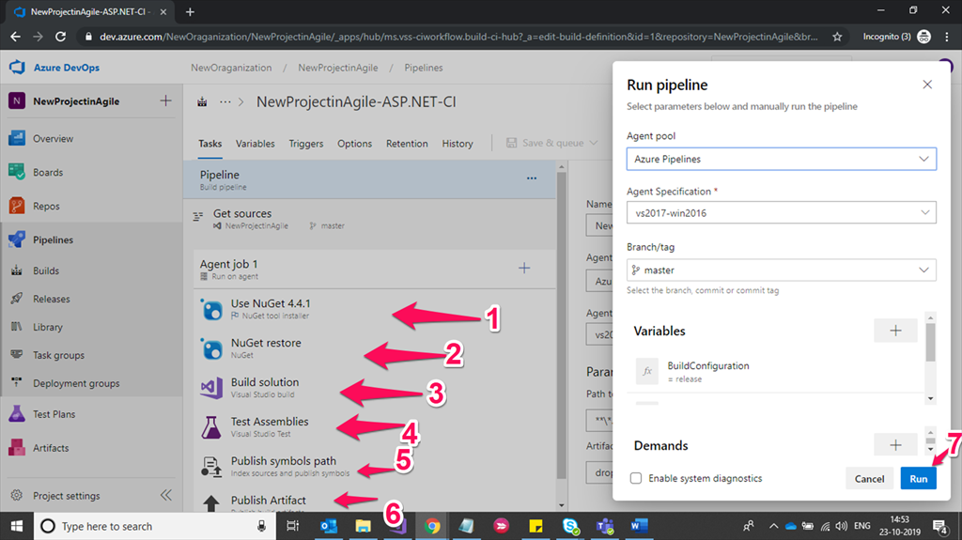

Slide 54
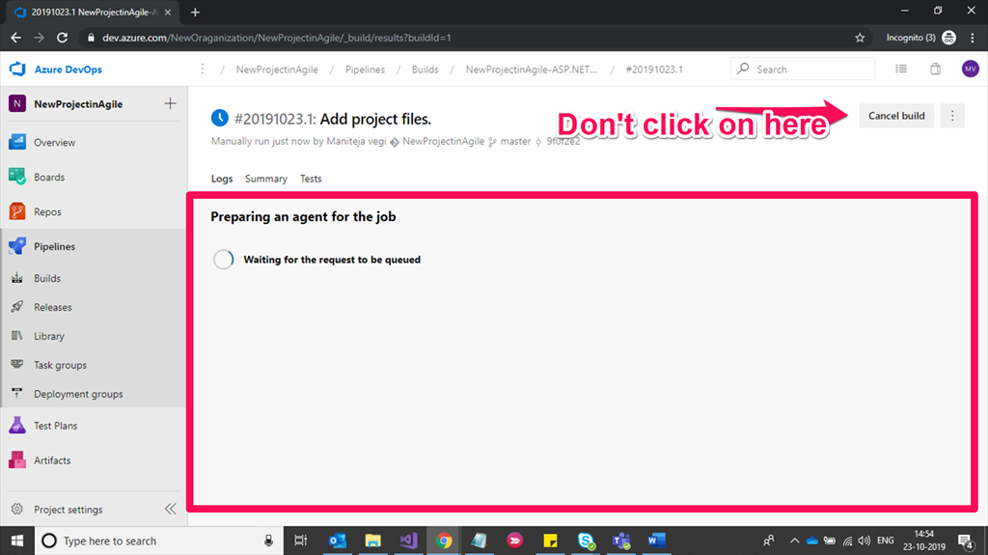
Once you click on run, agent job will run for CI (Continuous Integration),

Slide 55
If we’ve any errors in our code or Missing any DLL’s or issue with restoring nuget package manager paths, then build failed and log in information for build will be available here to monitor the failed cases & issues. Once all agent job stages are succeeded without any error or failed cases, then build was succeeded and ready to configure release, For Release creation, Click on Release button shown in the below screenshot.

Slide 56
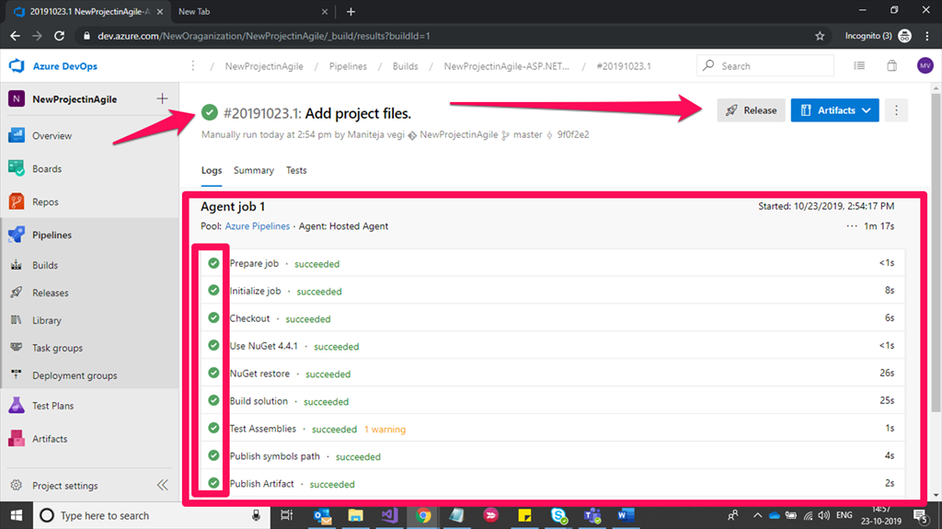

Slide 58
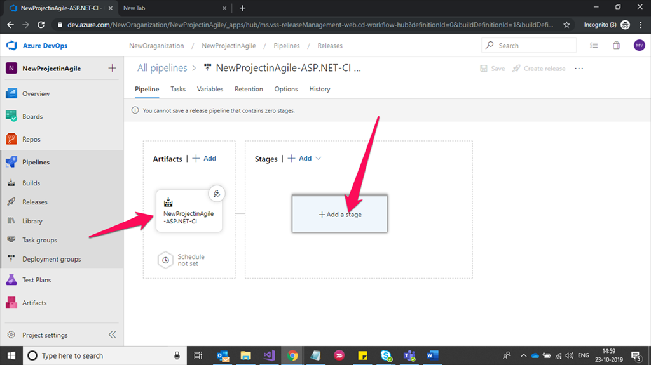

Slide 59
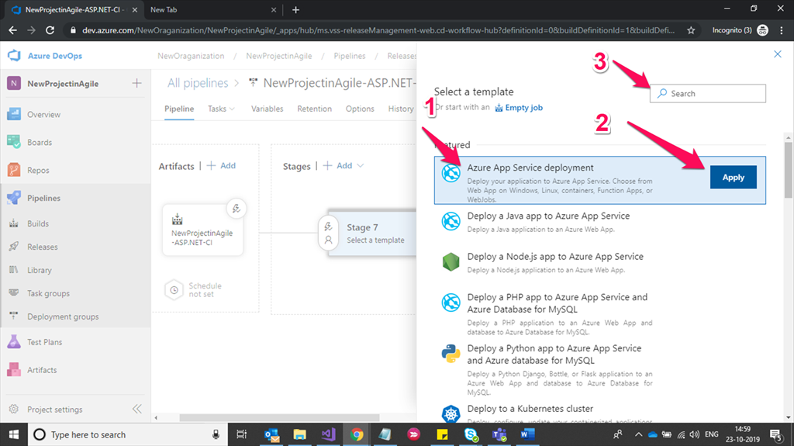

Slide 60
Click on Add a stage and give proper name to your release stages. For every project we have Dev, QA (Test), UAT & Production. Here I’m showing only single stage (Cloud_Host) to deploy our code. I’ll try to explore more about stages and replacing environmental variables for each environment in upcoming articles.

Slide 61
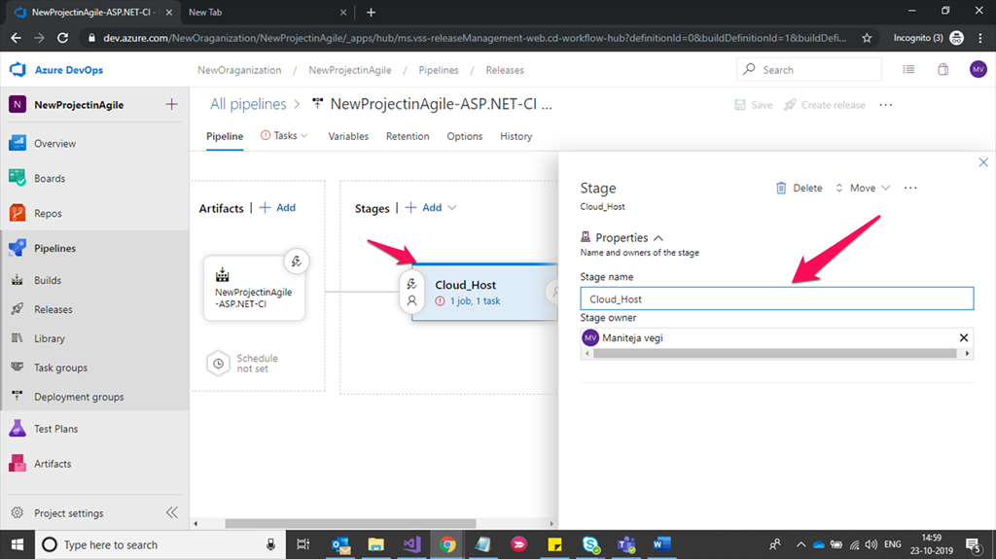

Slide 62
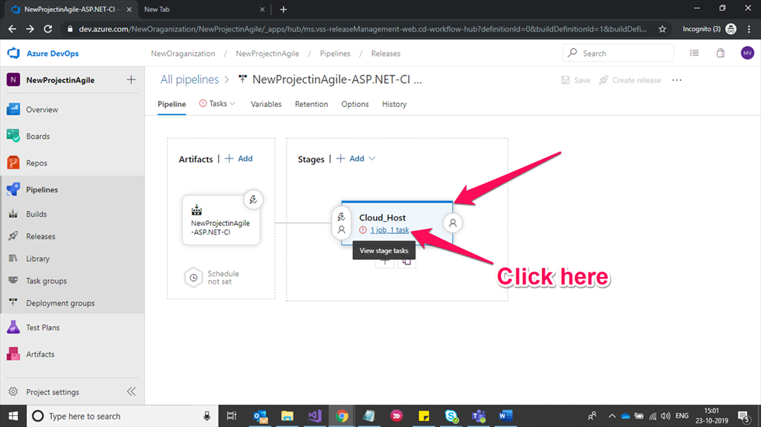
Click on View stage tasks shown in below screenshot,

Slide 63
You’ve to fill Azure subscription details by clicking on Manage option. Based on selected Azure subscription details you’ll get Azure app services details which are allocated in resource groups.
Adding or Managing your Azure resources subscription details to configure CI & CD pipeline.
If you already configured Azure subscription with your email id, you need to select in drop-down list as shown in below screenshot.
Select App type( Here I'm using Azure web app services(PAAS) to deploy my solution).
Select valid web app services which we are going to publish.
You can add agents if required by clicking on '+' symbol here(not suggested for RND)

Slide 64
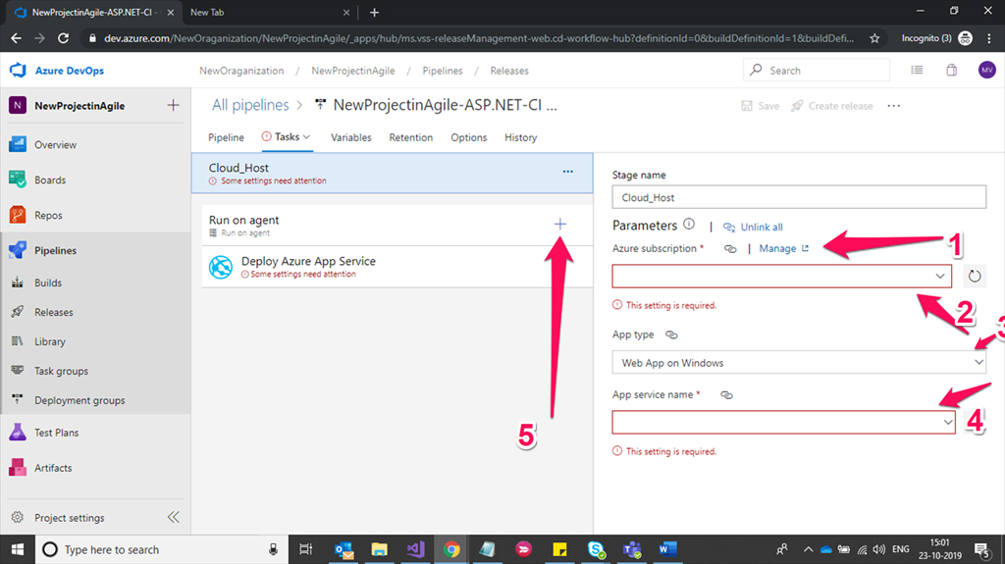

Slide 65
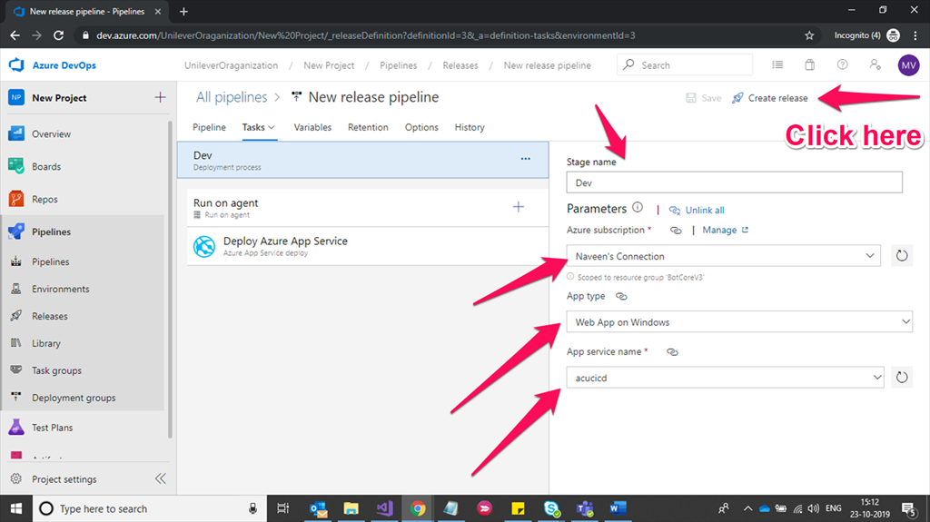
Once app service configuration is done, click on Create Release.

Slide 66
Continuous Deployment
After clicking on create release button, CD (Continuous Deployment) will be activated once you click on create button shown in below screenshot.

Slide 67
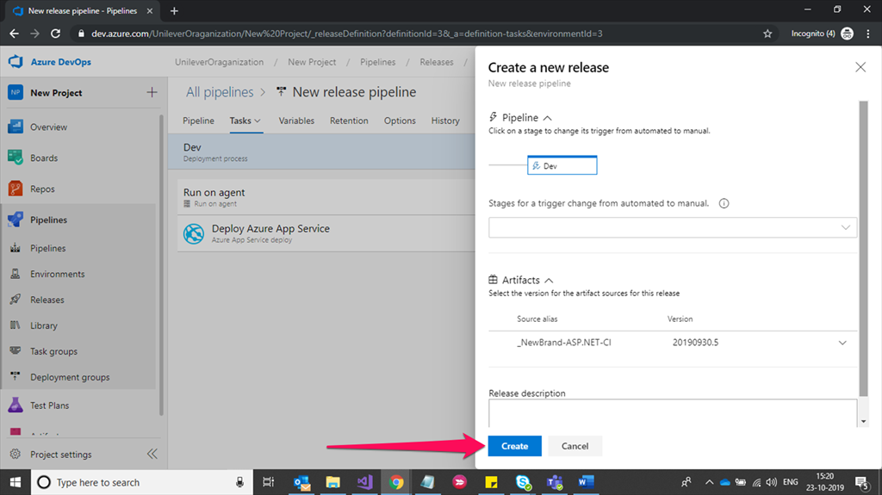

Slide 68
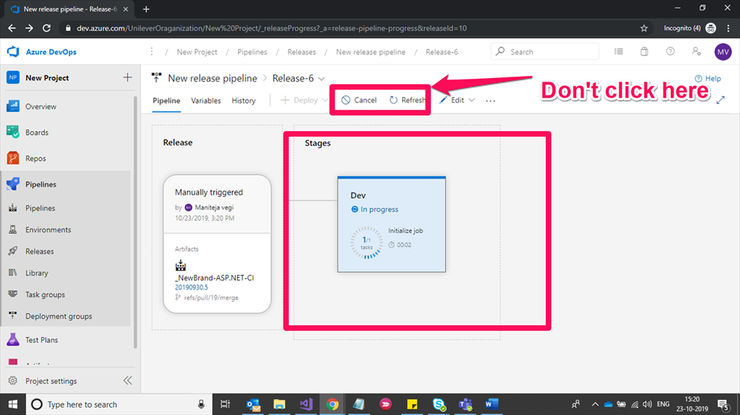
For first release, automatic deployments will start and are shown in the below screenshot.

Slide 69
Once our deployment is done successfully for configured stage we have information for each releases and deployment information is shown in the below screenshot.

Slide 71
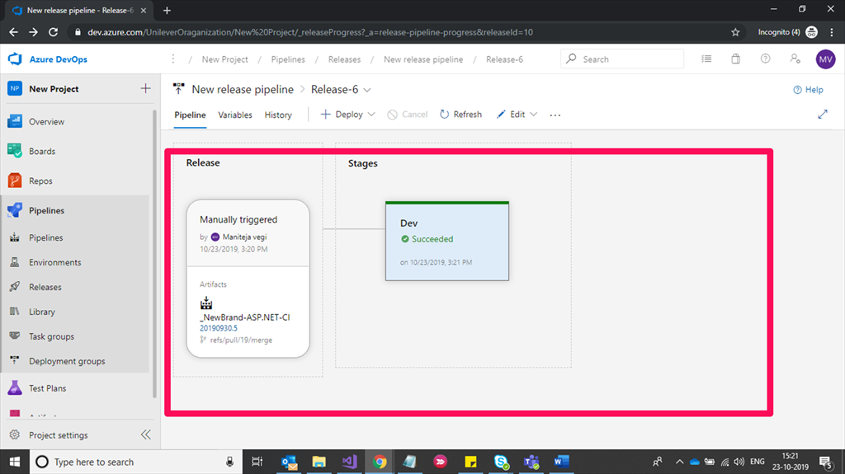
Continuous Integration = Build Pipeline

Slide 72
we configured only build and release pipelines. Initial setup for development will help this article to configure CI and CD configuration for your project delivery.

Slide 73
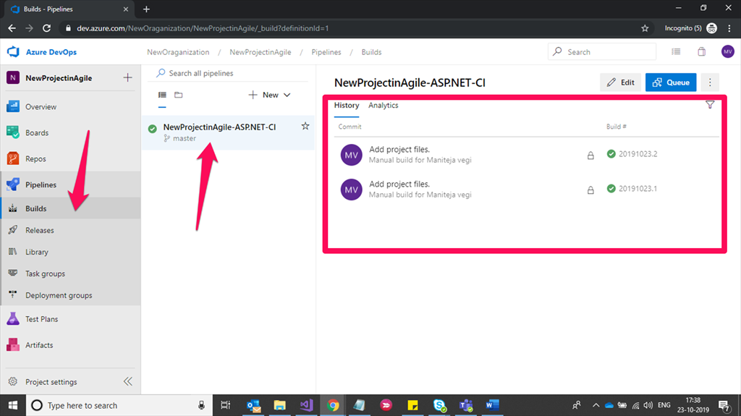

Slide 74
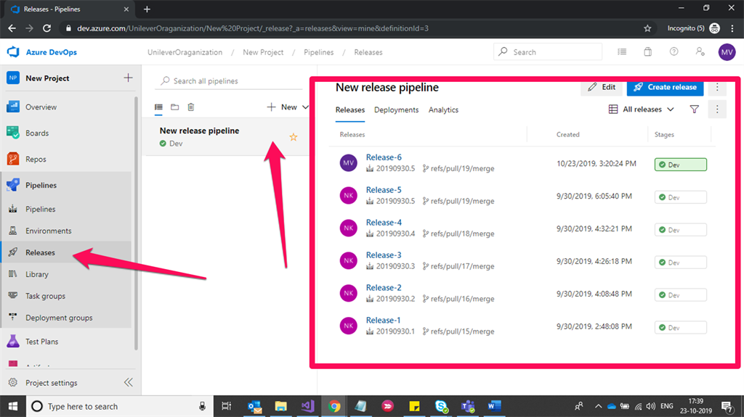
Continuous Deployment = Release Pipeline.

Slide 75
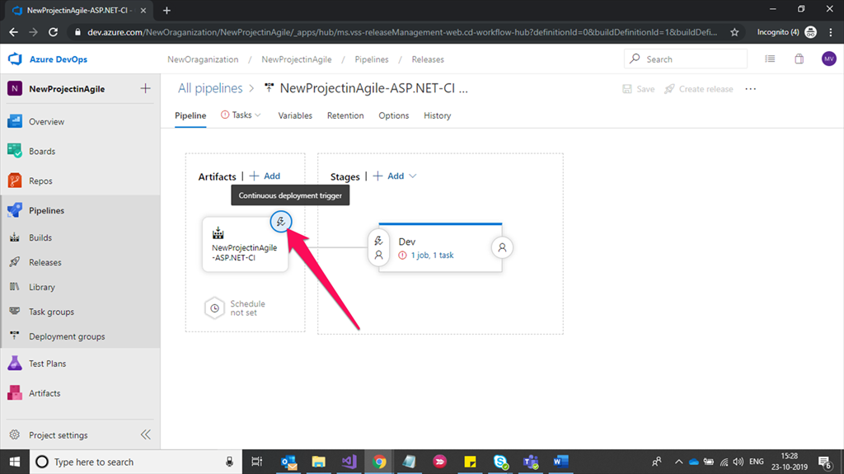
Continuous Deployment Trigger
This is option we can use to deploy our code by using CI & CD pipeline to automate the deployment process.

Slide 76
Default Build {ArtefactName}- CI option is enabled to automate deploy. If in case it is disabled, automatic deployment was not done if build (CI { Continuous Integration } ) is succeeded. This is the option to check where deployment has not happened when PR’s is approved or build was succeeded.

Slide 77
Pull Request Trigger
We’ve options to pull request enable trigger, and build branch filters trigger.
Now here we are automating continuous deployment for every Pull request (Commits, Check-ins) approved by manager by enabling pull request trigger.
Default option is disabled to deploy the code for every pull request approved by manager or TL’s after code review.
Enabling branching policies will helps to avoid failures in CI and CD process.

Slide 78
Branching Policies
Reviewer's approval required for every Pull Request
Code review comments should be resolved in raised Pull Requests.
Build Succeeded (Choosing a build pipeline (CI) to build your code).
Interlinked work items should be completed (Work items traceability).

Slide 79
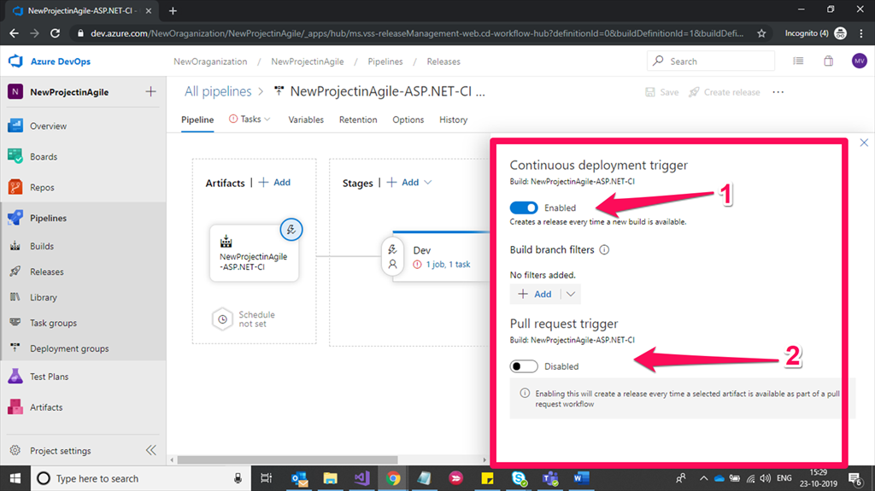

Slide 80
Pull Request Trigger
By enabling this option, it will create a new version of artifact to deploy the code and this information will be available in the release once it is successful or failed in the deployment process. You’ve to select a targeted branch to build a new version of artifact, no worries about save button, it is auto-saved as configured.

Slide 81
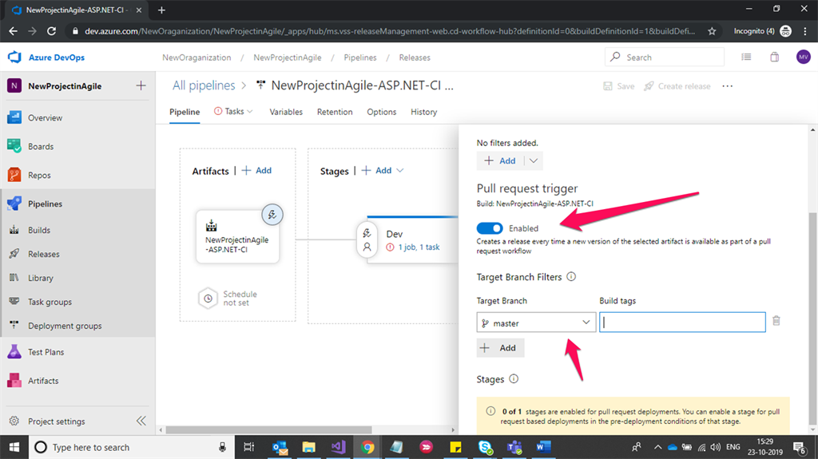

Slide 82
Pre-deployment Conditions
Pre-deployment Conditions
We have pre-deployment conditions to trigger configured deployment work-flow for CD (Continuous Deployment).

Slide 83
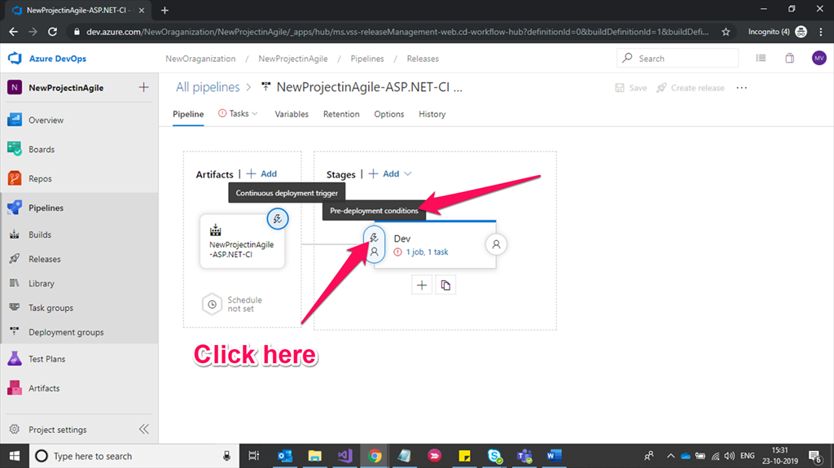

Slide 84
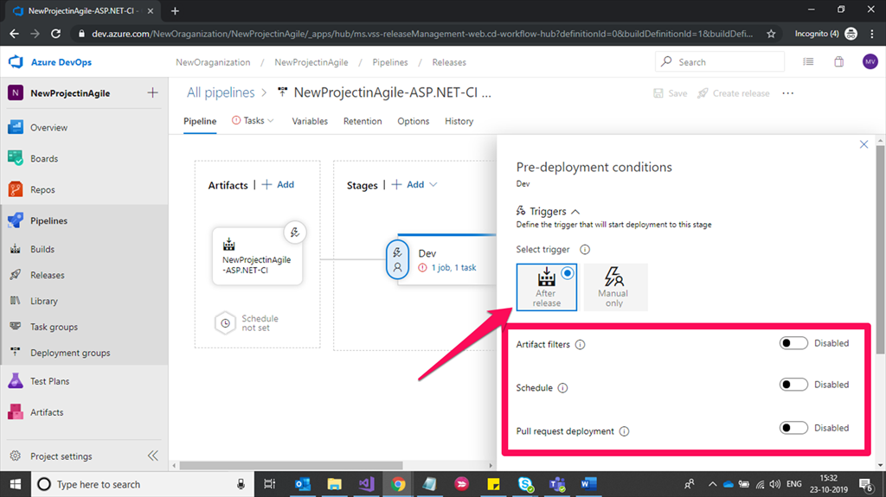

Slide 85
Artifact Filters
Select artifact condition(s) to trigger a new deployment. A release will be deployed to this stage only if all artifact conditions match.
Gates: Define gates to evaluate before the deployment.
Deployment queue settings: Define behavior when multiple releases are queued for deployment

Slide 86
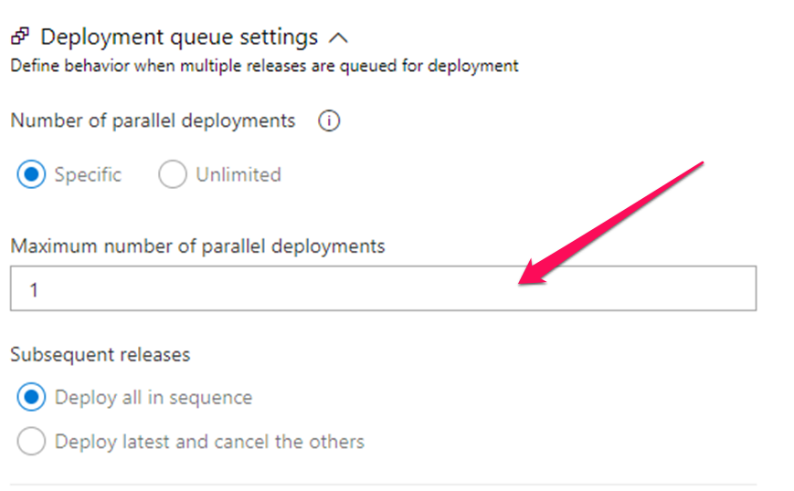

Slide 87
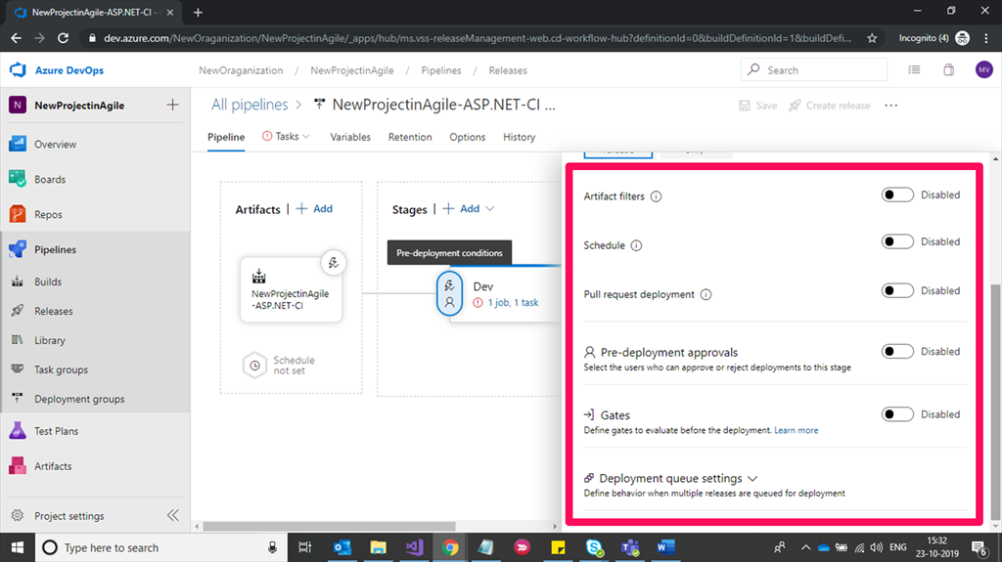

Slide 88
Schedule: Trigger a new deployment to this stage at a specified time.

Slide 89
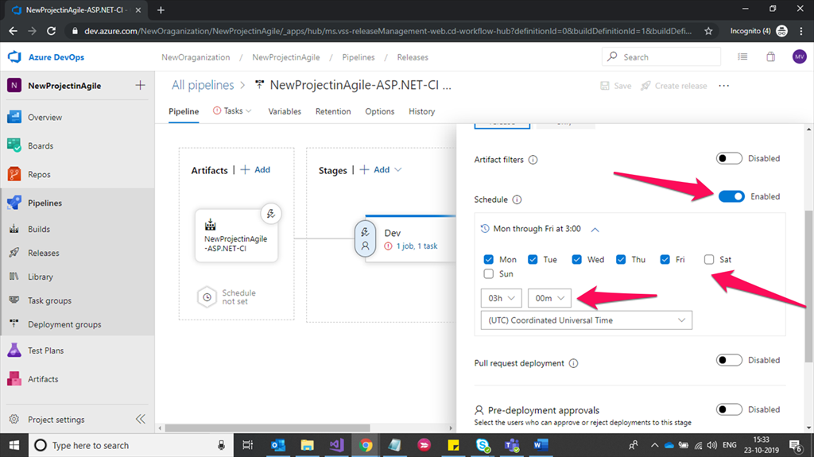

Slide 90
Pull Request Deployment: Enabling this will allow pull request-based releases to be deployed to this stage. Keep it disabled if this is a critical or production stage.

Slide 91


Slide 92
Pre-Deployment Approval: Select the users who can approve or reject deployments to this stage

Slide 93


Slide 94
Gates: Defining gates to evaluate before the deployment by giving delay time to code publish.

Slide 95


Slide 96
Deployment queue settings: Define behavior when multiple releases are queued for deployment.

Slide 97


